Slide 1



Junior Interface Developer
Modulo 01 - Visual Studio, .NET Framework e C#
Da Lunedì 19/09/2016 a Lunedì 26/09/2016
Gabriele Gaggi

Slide 2
Contenuto del modulo
Visual Studio: un unico ambiente di sviluppo per tutti i progetti
Introduzione al linguaggio C#
Istruzioni di controllo flusso
Gestione delle stringhe, delle date e dei numeri
Programmazione ad oggetti in C#.NET
Database relazionali

Slide 3
Parte 1 - Visual Studio: un unico ambiente di sviluppo per tutti i progetti
Template disponibili nell’ambiente di sviluppo
Scrivere codice .NET usando C#
Potenzialità ed interoperabilità dei linguaggi .NET
Scrivere, compilare ed eseguire le applicazioni
Commentare il codice
Organizzazione di soluzioni e progetti
Le finestre di Visual Studio: Error list, Breakpoint, Watch, Output, eccetera

Slide 4
Visual Studio .NET
Microsoft Visual Studio is a modern IDE
IDE : Integrated Development Envinronment
You can use Visual Studio to create any kind of application
Use your Microsoft Account to synchronize settings and manage your subscription

Slide 5
Template disponibili nell’ambiente di sviluppo
Windows Desktop Application
Console Application
Web Application (website and web-service)
Mobile Application
Microsoft Office
Cloud application (Azure)

Slide 6
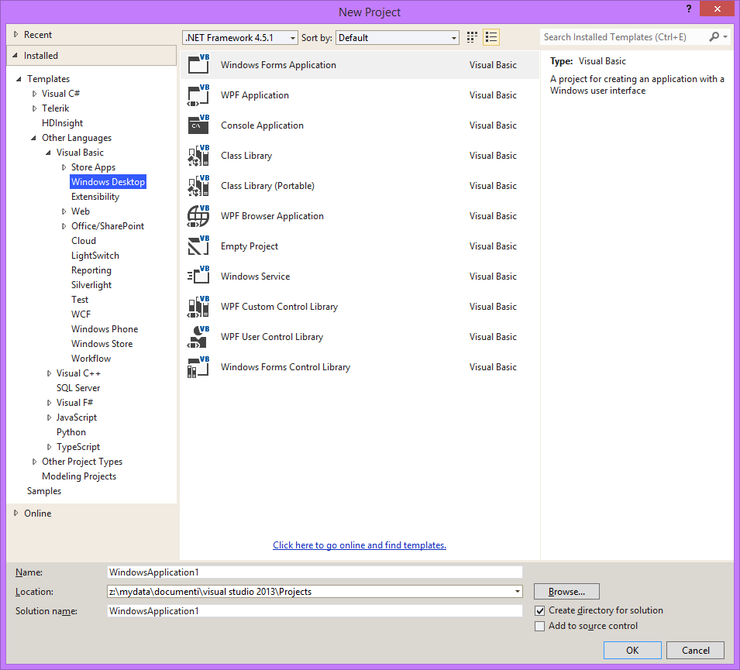
Template disponibili nell’ambiente di sviluppo

Slide 7
Visual Studio .NET
Using Microsoft Visual Studio you can:
Create application
Debug application
Deploy application
Microsoft Visual Studio supports any language included in the .NET Framework (C#, Visual Basic .NET, F#, C++)

Slide 8
Visual Studio .NET
To create an application - choose the right template - give a name to your solution - click Ok on the dialog
You can install additional project templates

Slide 9
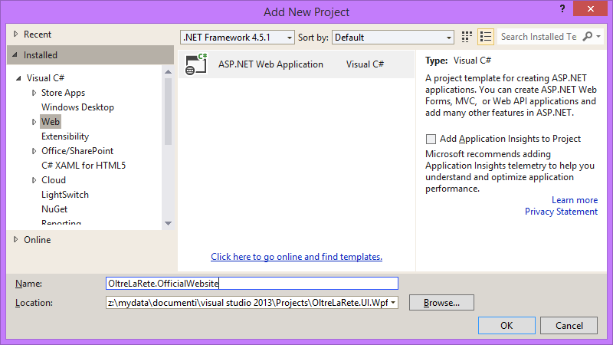
Visual Studio .NET

Slide 10
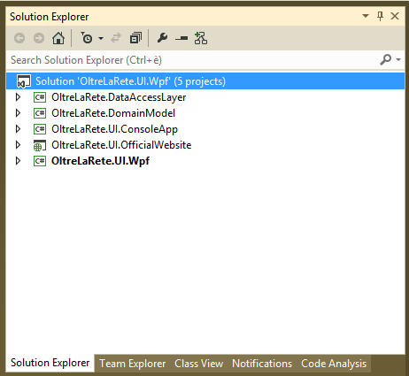
Organizzazione di soluzioni e progetti
When you create a new project using Visual Studio, you create a solution
A solution can contain one or more projects

Slide 11
Organizzazione di soluzioni e progetti
Visual Studio provides two containers to help you efficiently manage the items that are required by your development effort, such as references, data connections, folders, and files
These containers are called solutions and projects. You use Solution Explorer to view and manage projects and solutions and their associated items.
Solutions contain items that you need in order to create your application. A solution includes one or more projects, plus files and metadata that help define the solution as a whole.
Visual Studio automatically generates a solution when you create a new project. Visual Studio stores the definition for a solution in two files: .sln and .suo.
Projects are used in a solution to logically manage, build, and debug the items that make up your application
The output of a project is usually an executable program (.exe), a dynamic-link library (.dll) file or a module, among others

Slide 12
Debugging e gestione degli errori
Visual Studio has many toolbar, window and feature to help you during the creation of the application
You can detect and fix any bug
You can set a breakpoint to enter in “break mode”
You can watch and edit variable values
You can develop apps faster by using the Error List window. For example, you can perform the following tasks:
Display the errors, warnings, and messages produced as you edit and compile code
Find syntax errors noted by IntelliSense

Slide 13
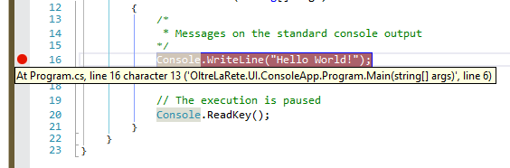
Debugging e gestione degli errori
You can set a breakpoint to stop the execution of the application
When you enter in “break mode” you can see and edit variables and objects
To set a breakpoint, press F9 on your keyboard or click on the left side of the workspace window

Slide 14
Debugging e gestione degli errori
Feature available in «break mode»
Step Over F10
Step Into F11
Step Out Shift + F11
Run To Cursor Ctrl + F10

Slide 15





Cos’è il framework .NET
Common Language Runtime
Class Library
Development Frameworks

Slide 16
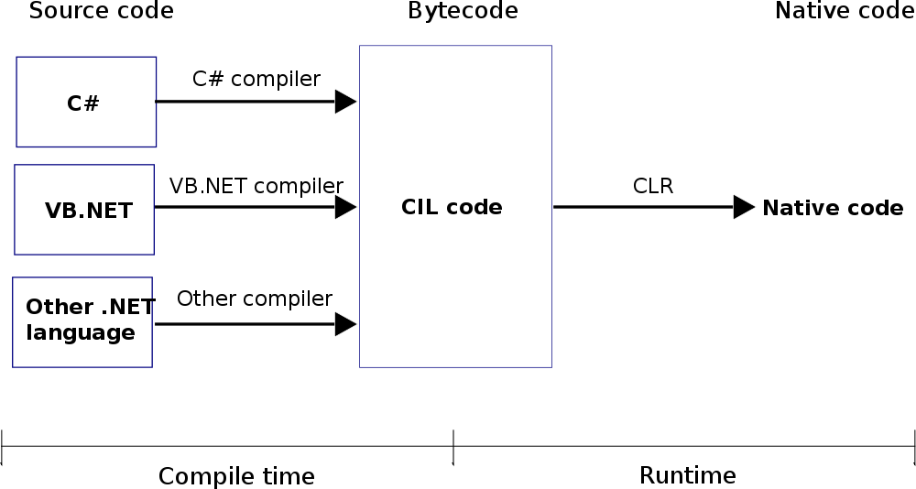
Il CLR

Slide 17
Le versioni del framework .NET
Microsoft cominciò lo sviluppo della tecnologia .NET verso la fine degli anni novanta, sotto il nome di Next Generation Windows Services (NGWS). La prima beta del Framework .NET fu distribuita verso la fine del 2000. Il framework è stato quindi aggiornato più volte nel corso degli anni.

Slide 18
Le versioni del framework .NET
Versione | Build pubblicata | Data di distribuzione
1.0 | 1.0.3705.0 | 05/01/2002
1.1 | 1.1.4322.573 | 01/04/2004
2.0 | 2.0.50727.42 | 07/11/2005
3.0 | 3.0.4506.30 | 06/11/2006
3.5 | 3.5.21022.8 | 19/11/2007
4.0 | 4.0.30319.1 | 12/04/2010
4.5 | 4.5.40805 | 29/02/2012
4.5.1 | 4.5.1 | 17/10/2013
4.5.2 | 4.5.2 | 06/05/2014
4.6 | 4.6 | 11/2014
4.6.1 | 4.6.1055.0 | 06/11/2015

Slide 19
Il Common Intermediate Language
.assembly extern mscorlib{}
.assembly CiaoMondo{}
.method public hidebysig static void Main() cil managed
{
.entrypoint
ldstr "Ciao mondo."
call void [mscorlib]System.Console::WriteLine(string)
ret
}

Slide 20
Linguaggi supportati
Visual Basic .Net
C#
C++
Molti altri.. https://en.wikipedia.org/wiki/List_of_CLI_languages

Slide 21
Parte 2 - Introduzione al linguaggio C#
CLR - Common Language Runtime
Architettura del .NET Framework
I Namespaces
Assegnazione dei nomi e parole riservate
Tipi di dato semplici
Variabili e costanti
Gli array e ArrayList
Operatori del linguaggio
Creare una funzione
Funzioni parametrizzate

Slide 22
Introduzione al linguaggio C#
C#
C# is the language of choice for many developers who build .NET Framework applications
C# uses a very similar syntax to C, C++, and Java
C# has been standardized and is described by the ECMA-334 C# Language Specification

Slide 23

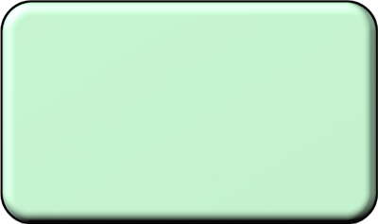



Introduzione al linguaggio C#: Assembly
Building blocks of .NET Framework applications
Collection of types and resources that form a logical unit of functionality
MyAssembly .dll OR .exe
Assembly signed with a digital certificate
MyClassA
MyResource
MyClassB
V 1.1.254.1

Slide 24


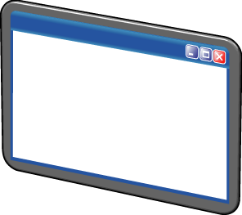
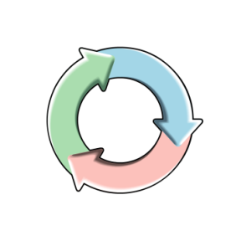
Introduzione al linguaggio C#: CLR
Assemblies contain MSIL code, which is not actually executable
The CLR loads the MSIL code from an assembly and converts it into the machine code that the computer requires
Loads assemblies that the application references
1
Verifies and compiles assemblies into machine code
2
Runs the executable assembly
3

Slide 25
Introduzione al linguaggio C#
Program execution begins at Main( )
The using keyword refers to resources in the .NET Framework class library
Statements are commands that perform actions
A program is made up of many separate statements
Statements are separated by a semicolon
Braces are used to group statements
using System;
class HelloWorld {
static void Main() {
Console.WriteLine ("Hello, World");
}
}

Slide 26
Introduzione al linguaggio C#
Use indentation to indicate enclosing statements
C# is case sensitive
White space is ignored
Indicate single line comments by using //
Indicate multiple-line comments by using /* and */

Slide 27


I Namespaces
A class is essentially a blueprint that defines the
characteristics of an entity
A namespace represents a logical collection of classes
System.IO namespace
File class
FileInfo class
Path class
DirectoryInfo class
Directory class

Slide 28
I Namespaces
Use namespaces to organize classes into a logically related hierarchy
.NET Class Library includes:
System.Windows
System.Data
System.Web
Define your own namespaces.
Use namespaces:
Add reference to containing library
Add using directive to code file

Slide 29

I Namespaces
Bring System namespace into scope
using System;
namespace MyFirstApplication
{
class Program
{
static void Main(string[] args)
{
}
}
}
Namespace declaration
Program class declaration
Main method declaration

Slide 30
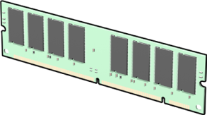
Variabili e costanti
Variables store values required by the application in temporary memory locations
Variables have the following facets:
Name
Address
Data type
Value
Scope
Lifetime

Slide 31

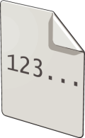
Variabili e costanti
C# is type-safe language
The compiler guarantees that values stored in variables are always of the appropriate type
Data types include:
int
char
long
bool
float
DateTime
double
string
decimal

Slide 32
Variabili e costanti
Before you can use a variable, you must declare it
DataType variableName;
…
DataType variableName1, variableName2;
…
DataType variableName = new DataType();
After you declare a variable, you can assign a value to it
variableName = Value;
…
DataType variableName = Value;
NOTE: Variable name is known as an identifier. Identifiers must:
Only contain letters, digits, and underscore characters
Start with a letter or an underscore
Not be one of the keywords that C# reserves for its own use

Slide 33
Variabili e costanti
Declaring
Assign a type
Assign a name
End with a semicolon
int numberOfVisitors;
1
2
string bear;
3
Initializing
Use assignment operator
Assign a value
End with a semicolon
1
string bear = "Grizzly";
2
3
Assigning literal values
Add a type suffix
decimal deposit = 100M;
1

Slide 34
Variabili e costanti: Conversioni
Implicit conversion
Automatically performed by the common language runtime
int a = 4;
long b;
b = a; // Implicit conversion of int to long
Explicit conversion
May require you to write code to perform the conversion
DataType variableName1 = (castDataType) variableName2;
…
int count = Convert.ToInt32("1234");
...
int number = 0;
if (int.TryParse("1234", out number)) {// Conversion succeeded }

Slide 35
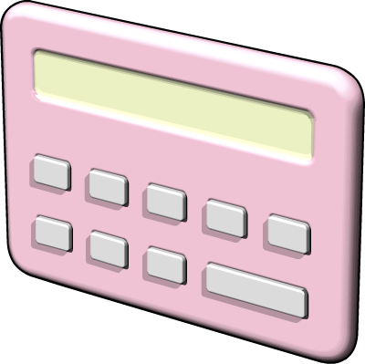
Operatori del linguaggio: Espressioni
Expressions are the fundamental constructs that you use to evaluate and manipulate data
a + 1
(a + b) / 2
"Answer: " + c.ToString()
b * System.Math.Tan(theta)

Slide 36
Operatori del linguaggio
Operators are character sequences that you use to define operations that are to be performed on operands
Arithmetic +, -, *, /, %
Assignment =, +=, -=, *=, /=
Increment, decrement ++, --
Bit shift <<, >>
Comparison ==, !=, <, >, <=, >=, is
Type information sizeof, typeof
String concatenation +
Delegate concatenation +, -
Logical/bitwise &, |, ^, !, ~, &&, ||
Overflow checked, unchecked
Indexing [ ]
Indirection, Address *, ->, [ ], &
Casting ( ), as
Conditional (ternary operator) ?:

Slide 37


Operatori del linguaggio: Precedenza
Highest
++, -- (prefixes), +, - (unary), !, ~
*, /, %
+, -
<<, >>
<, >, <=, >=
==, !=
&
^
|
&&
||
Assignment operators
Lowest
++, -- (suffixes)

Slide 38
Parte 3 - Istruzioni di controllo flusso
Istruzioni condizionali: if...else / else if / switch
Istruzioni di iterazione: for / foreach / while / do...while

Slide 39
Istruzioni condizionali: if...else / else if / switch
Syntax
if ([condition]) [code to execute]
// OR
if ([condition])
{
[code to execute if condition is true]
}
Conditional operators:
OR represented by ||
AND represented by &&
Example
if ((percent >= 0) && (percent <= 100))
{
// Add code to execute if a is greater than 50 here.
}

Slide 40
Istruzioni condizionali: if...else / else if / switch
Provide an additional code block to execute if [condition] evaluates to a Boolean false value
Example
if (a > 50)
{
// Greater than 50 here
}
else
{
// less than or equal to 50 here
}
// OR
string carColor = "green";
string response = (carColor == "red") ?
"You have a red car" :
"You do not have a red car";

Slide 41
Istruzioni condizionali: if...else / else if / switch
You can combine several if statements to create a multiple-outcome statement
Example
if (a > 50)
{
// Add code to execute if a is greater than 50 here.
}
else if (a > 10)
{
// Add code to execute if a is greater than 10 and less than
// or equal to 50 here.
}
else
{
// Add code to execute if a is less than or equal to 50 here.
}

Slide 42
Istruzioni condizionali: if...else / else if / switch
The switch statement enables you to execute one of several blocks of code depending on the value of a variable or expression
Example
switch (a)
{
case 0:
// Executed if a is 0.
break;
case 1:
case 2:
case 3:
// Executed if a is 1, 2, or 3.
break;
default:
// Executed if a is any other value.
break;
}

Slide 43
Istruzioni condizionali: if...else / else if / switch
Use an if structure when you have a single condition that controls the execution of a single block of code
Use an if/else structure when you have a single condition that controls the execution of one of two blocks of code
Use an if/elseif/else structure to run one of several blocks of code based on conditions that involve several variables
Use a nested if structure to perform more complicated analysis of conditions that involve several variables
Use a switch statement to perform an action based on the possible values of a single variable

Slide 44



Istruzioni di iterazione: for / foreach / while / do...while
Iteration statements include:
while
A while loop enables you to execute a block of code zero or
more times
do
A do loop enables you to execute a block of code one or
more times
for
A for loop enables you to execute code repeatedly a set number
of times

Slide 45
Istruzioni di iterazione: for / foreach / while / do...while
The syntax of a while loop contains:
The while keyword to define the while loop
A condition that is tested at the start of each iteration
A block of code to execute for each iteration
Example
double balance = 100D;
double rate = 2.5D;
double targetBalance = 1000D;
int years = 0;
while (balance <= targetBalance)
{
balance *= (rate / 100) + 1;
years += 1;
}

Slide 46
Istruzioni di iterazione: for / foreach / while / do...while
The syntax of a do loop contains:
The do keyword to define the do loop
A block of code to execute for each iteration
A condition that is tested at the end of each iteration
string userInput = "";
do
{
userInput = GetUserInput();
if (userInput.Length < 5)
{
// You must enter at least 5 characters.
}
} while (userInput.Length < 5);

Slide 47
Istruzioni di iterazione: for / foreach / while / do...while
The syntax of a for loop contains:
The for keyword to define the for loop
The loop specification (counter, starting value, limit, modifier)
A block of code to execute for each iteration
Example
for (int i = 0; i < 10; i++)
{
// Code to loop, which can use i.
}

Slide 48
Istruzioni di iterazione: for / foreach / while / do...while
Break statement
while (oldNumbers.Length > count)
{
if (oldNumbers[count] == 5)
{
break;
}
count++;
}
Enables you to exit the loop and skip
to the next line of code
Continue statement
while (oldNumbers.Length > count)
{
if (oldNumbers[count] == 5)
{
continue;
}
// Code that won't be hit
count++;
}
Enables you to skip the remaining code in the current iteration, test the condition, and then start the next iteration of the loop

